Slide 1
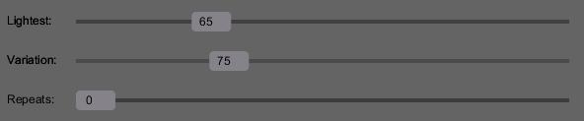
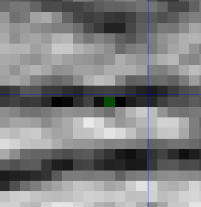
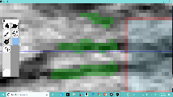
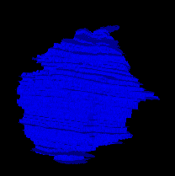
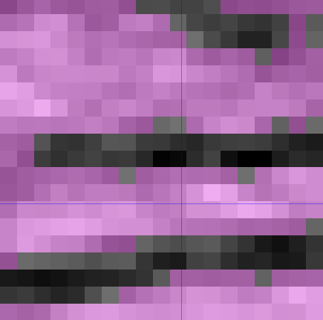
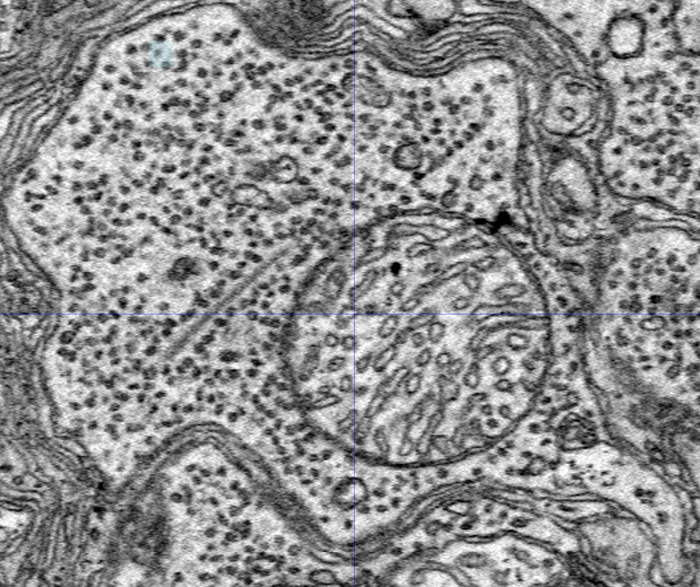
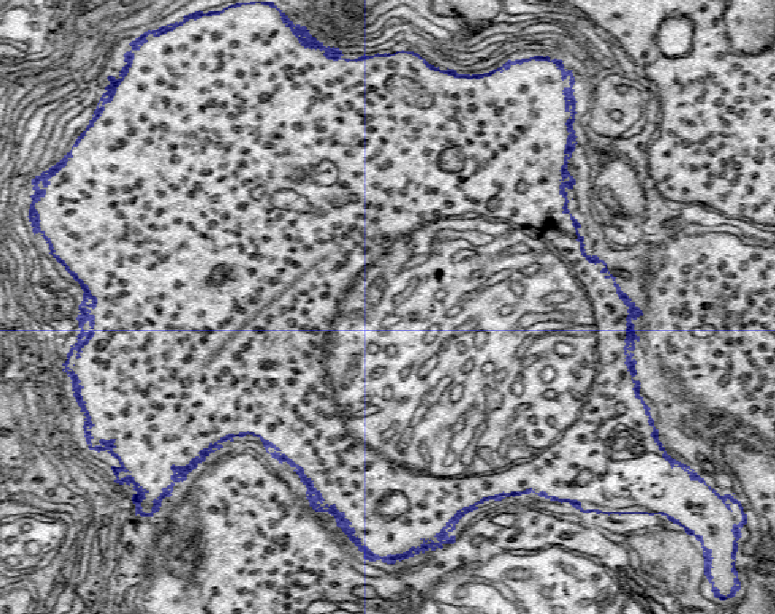
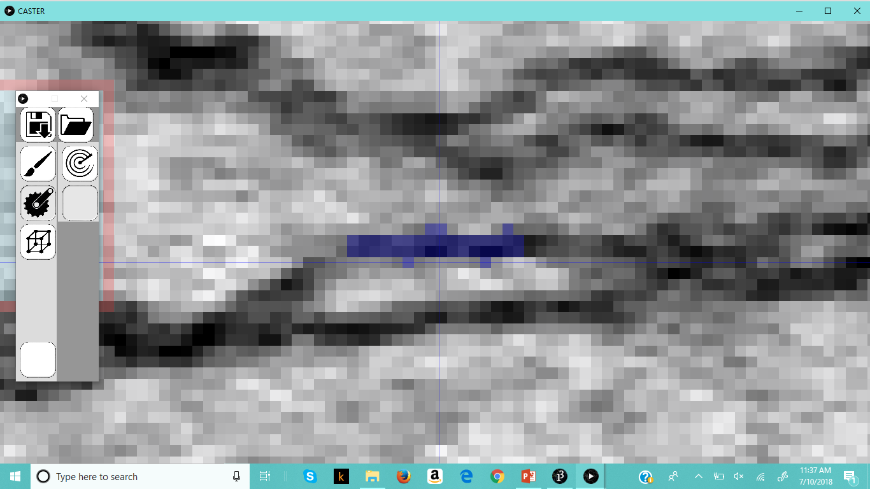
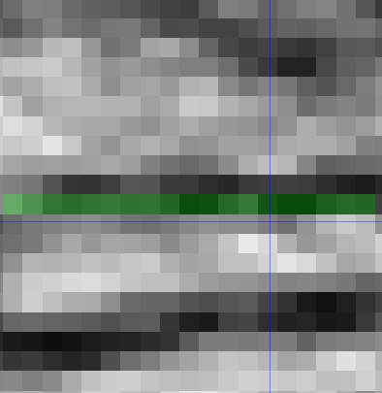
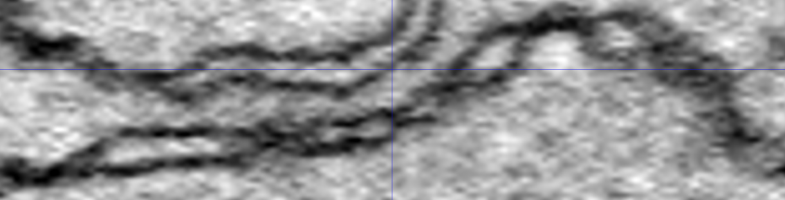
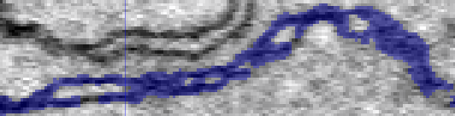

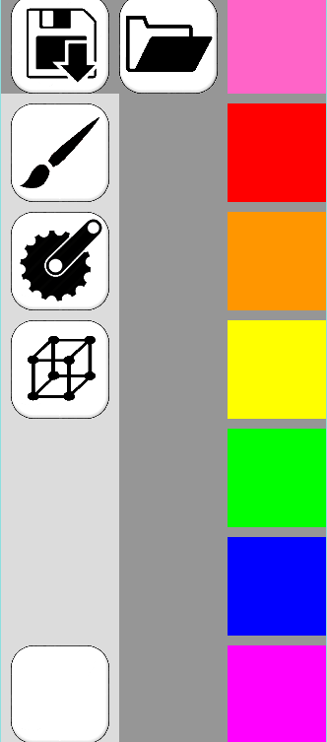
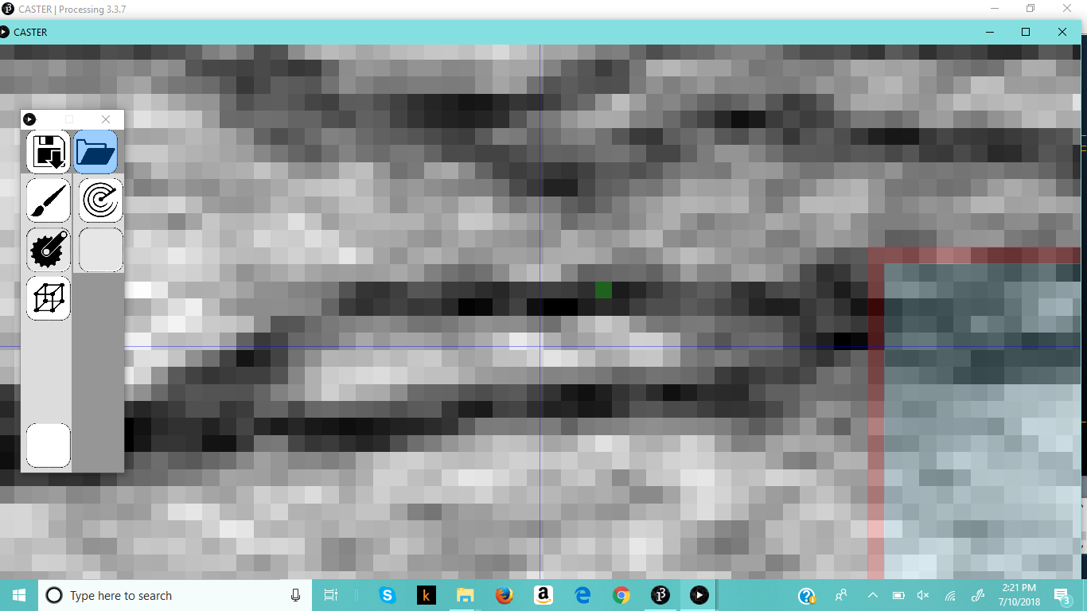

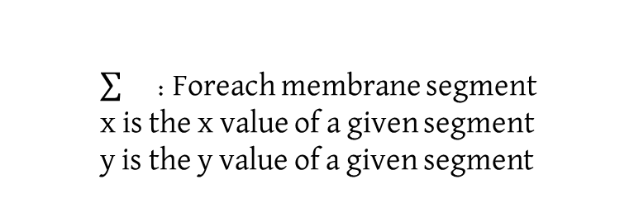

Inland 360
DeLaney Jones, Khristopher Six, Jeffrey DeBoer,
Fangfei Zhang, Manwar Sabaeai, Brycen Cloward, Karl Lundgren
Title
Why should people care about this app? How is it relevant to them and what is the big picture?
How does it work?
We can put a device here to show people
Or even a photo of what’s going on
CASTER
Obtain the darkest color
Use linear regression analysis to find the slope of the line of best fit
Match the slope to the section
Locate a pixel on known membrane in the direction of the new section
Select pixels that are within the range
Select all pixels that are not in the range
Flood fill starting from known membrane
1.3 micrometers
Results
The first way to use CASTER is to set the number of boxes made to zero, turning off the automatic membrane outlining. This is helpful in areas where the contrast is not well defined. As the user drags their mouse, the program selects the points in that area that are most likely part of the membrane.
For each section of the current area, a ϵ A
Algorithm 1: Find locations of membrane segments
Input: Locations of possible membrane segments, T;
Locations of non-membrane segments, W;
Lightest acceptable color, l;
Amount of color variation allowed, v;
Center of current box, p;
Darkest color in current box, m;
Output: locations of membrane segments
(1) W ← { }
(2) Foreach a ϵ A
(3) If a ∉ T
(4) Add a to W
(5) If a > (m + v)
(6) Add a to W
(7) R ← { }
(8) Add p to R
(9) While R ≠ { }
r ← Remove the first item from R
N ← neighbors of a ϵ T
(12) Foreach n ϵ N
If n is not marked, and n ∉ W
Add n to R
Mark n
(16) Return R
Methods
5.8 micrometers
112.5°
6
67.5°
The second way is to set the number of boxes to anything else, and the program will highlight the well-defined membrane. The selected points are based on how the sliders were set. The user clicks on a single point on the membrane, and the program works outwards from there to select the membrane.
157.5°
2
1
22.5°
The kinds of methods that we used
I like to use QR Codes for people to scan in for informative videos if we have any.
A picture helps balance the poster
And people are more likely to look at a picture than read a wall of text…
7
5
337.5°
2.1 micrometers
202.5°
3
4
Algorithm 2: Linear Regression Analysis
247.5°
8
292.5°
$$\frac{\left(\sum{1} ∗ \sum{x} ∗ \sum{y}\right)−(\sum{x} ∗ \sum{y})}{(\sum{1 ∗ \sum{x^{2}}) − \sum{x^{2}}}}$$
: Foreach membrane segment
x is the x value of a given segment
y is the y value of a given segment
The QR code to the right links to an example video of the methods being used, as well as a completed 3D view of a rod spherule.
Algorithm 3: Find the center of the next box
Input: radians of line of best fit, r;
center of current box, p;
locations of membrane segments, B;
section being moved into, s;
Output: center of next box
(1) p2 ← (p.x + cos(r), p.y + sin(r))
(2) h ← p
(3) s ← $\sqrt{{\left(p2.x−p.x\right)}^{2}+({p2.y−p.y)}^{2}}$
(4) Foreach a
(5) if a is marked
(6) c ← $\sqrt{{\left(p2.x−a.x\right)}^{2}+({p2.y−a.y)}^{2}}$
(7) If c < s
(8) s ← c
(9) h ← a
(10) p2 ← h
(11) Return p2
5
II used this section for logos I needed to include
But I don’t think this poster really needs those
Can you think of any?
Or something else to place there.
Any citations we need to make
And any references what we should include

